Slide 1



Housing Project Case Study
October 6 - 13, 2022
Submitted by: Promise Azom

Slide 2
Outline
Data Description
EDA steps and Visualizations
Steps and Assumptions
Model Dashboard
Finalized Model & Conclusion

Slide 3

Data Description

Slide 4
Overall narrative summary of data: There are total 1168 and 292 observation in our Housing Training and Test dataset respectively.
There are total of 81 variables in our dataset.
We are going to be choosing 26 variables form the 81 variables. These variables are the features used.
Data contains Null values
Data contains numerical as well as categorical variable
1
2
3
4
5

Slide 5
Summary of Variables

Slide 6
Summary of Variables(Contd)

Slide 7
Summary of Variables(Contd)

Slide 8
Summary of Variables(Contd)

Slide 9

EDA STEPS
& VISUALIZATION

Slide 10
I employed both univariate, bivariate and multivariate analysis;
Plotted countplots, heatmaps, scatter plot and bar plots
Used only 26 features in the analysis because of the curse of dimensionality
I dropped 55 columns because they were not important in the analysis after applying SelectKBest
1
2
3
4

Slide 11

PROCESS STEPS & ASSUMPTIONS

Slide 12
I started by viewing the data and checking for null values;
I checked what kind of datatypes the dataset were made up of
I determined the target variable or labels.
I dropped columns with nulls greater than 900.
I choosed only 30 features using SelectKBest and finally used 30 features for the analysis after considering Multicollinearity
1
2
3
4
5

Slide 13
MODEL DASHBOARD

Slide 14
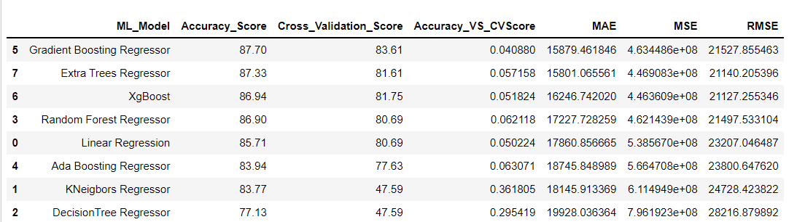
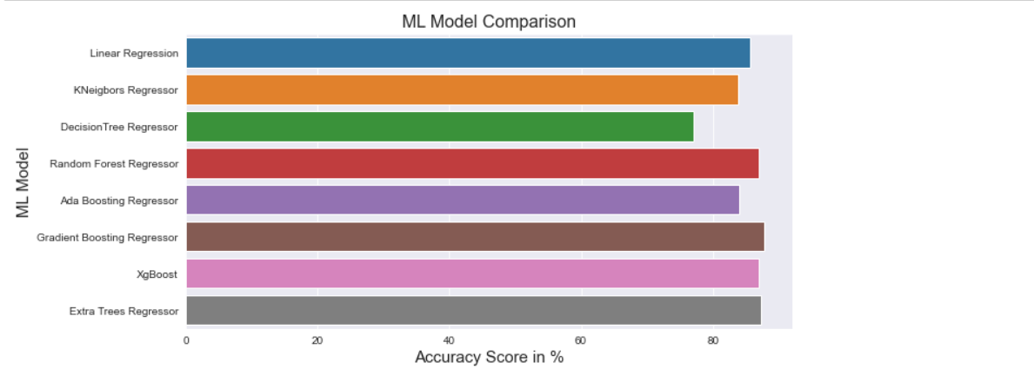
Comparing all Eight Models Built
Now from the above diagram it seems that Gradient Boosting Regrerssor(87.70%) has the highest Accuracy, However, our aim is to find the BEST MODEL, by considering the least difference Between Accuracy_Score and Cross_Validation_Score....

Slide 15
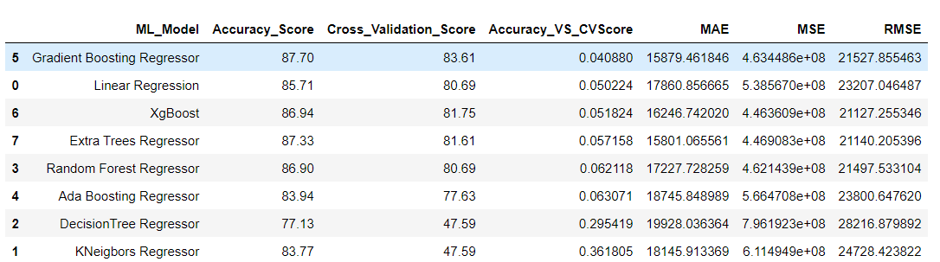
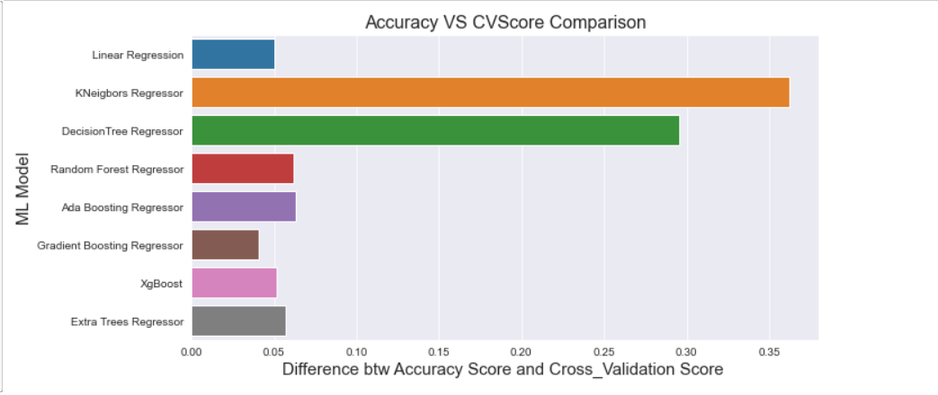
Comparing Differences between Accuracy and Cross_Validation Scores...
From the above we can see the Model with least difference is STILL GRADIENT BOOSTING REGRESSOR!

Slide 16

Finalized Model & Conclusion

Slide 17
1
From the above we can see:
- The Model with least difference (0.04) between Accuracy Score(r2 score) and Cross Validation Score is GRADIENT BOOSTING REGRESSOR!
2
Accuracy is 87%
We also went further to engage in Hyperparamter Tunning using
GridSearchCV
3
FINAL ACCURACY after Hyperparameter Tunning: 88%
4

Slide 18
Thank You

